Slide 1
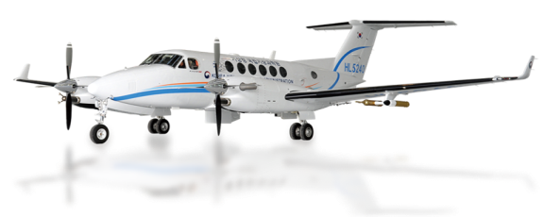
The 21th WMO/GAW Meeting on
Greenhouse Gases and Measurement Techniques (GGMT) 2022
Analysis Source Distribution of high CO and Aerosol events using Airborne and surface observations in South Korea
- KMA Scientific Aircraft programs over Korea -
Shanlan Li, Haeyoung Lee, Sumin Kim, Samuel Takele Kenea,
Jeong Eun Kim, Sang-Won Joo, Kyung-On Boo
National Institute of Meteorological Sciences(NIMS)/KMA, Korea

Slide 2
Talk Overview:
KMA/NIMS Atmospheric Research Aircraft
Introduction of King Air 350 aircraft,
Payloads, flight missions & design.
Aircraft Campaign at WMO/GAW surface station in Korea
Collect vertical profiles of CO₂, CH₄, CO and Aerosol

Slide 3
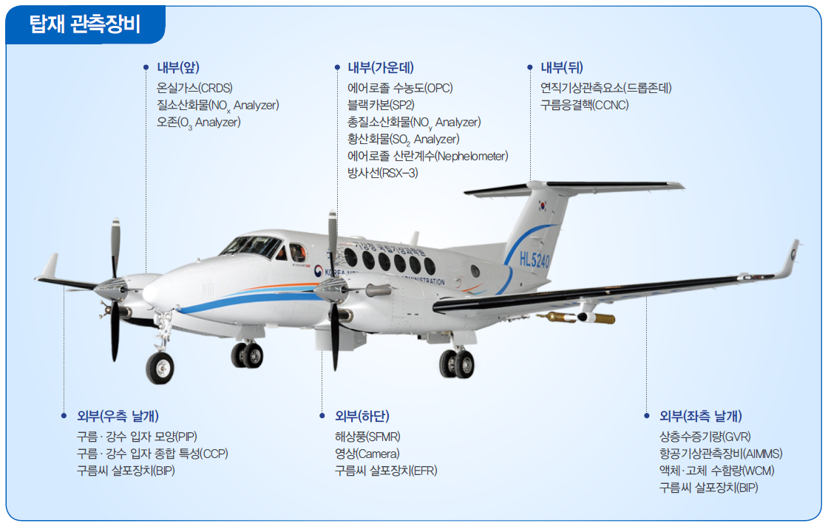
Payloads for King Air 350
25+2 Atmospheric Research Instrumentations
Aircraft: Beechcraft King Air 350HW
Payload
Picarro(CO₂, CH₄, CO, H₂O) G2401m
Thermo-42i (NOx)
Thermo-49i (O3)
Flask sampling package (Isotope)
(front-inside)
AVAPS-II
SP2, Sky-OPC, TAP
Thermo-43i
CCN-200
RSX-3
Nephelometer
(back-inside)
Dew point hygrometer
Icing Detector
(tall wing)
PIP
CCP(CIP+CDP)
(right wing)
SFMR
Camera
Ejectable Flare Rack
(bottom)
AIMMS-20
GVR
WCM 2000
Temperature Sensor
(left wing)
24 instrumentations & 5 crews
Max. altitude: ~30,000 ft;
flight time: 4.0 hrs depending on payloads
Speed: 70-120 m/s

Slide 4
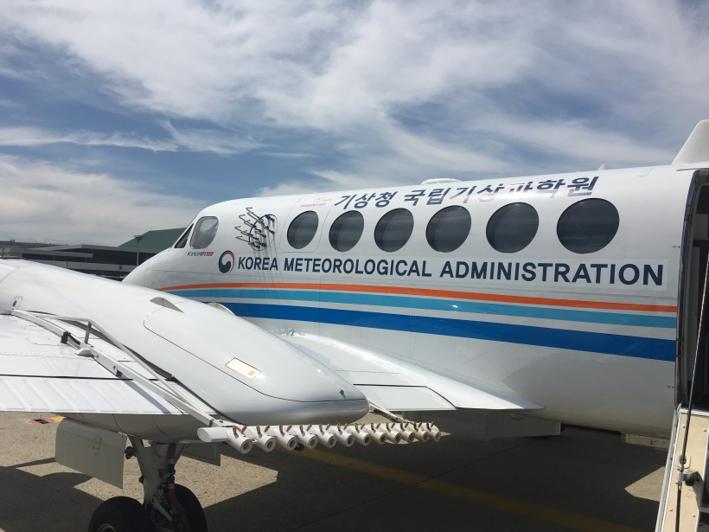
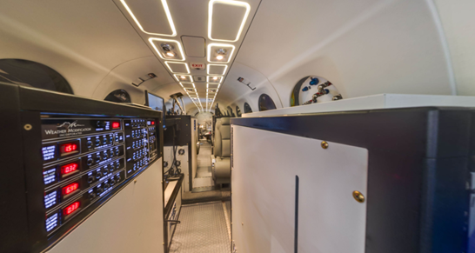
King Air 350 Aircraft Measurement Platform in Korea
Air inlet
Started the regular airborne measurements performance since 2018.
Manufacturer: Beechcraft
Engine category: Turbo-Prop
Max altitude: 9.0 km with maximum payloads
Mission flight: 4.5 hrs with maximum payloads
Speed: 70-120 m/s
Inlet: Mounted through an aluminum plate that replaces first circular window on aircraft
Crews on Board: two for pilot, two for payload operator, one for scientist to manage the scientific missions
Notes:
Airborne measurement platform has been established for regular observations with scientific purpose over South Korea since 2018.
We use an King Air 350, made by Beechcraft. It has a ceiling of 9.6km, speed 70-120 m/s, flying maximally 5.5 hours with payload, there are five seats, two for pilot, two for payload operator, one for scientist to manage the science missions.
The inlets delivering external air to instrumentation are mounted through an aluminum plate that replaces the first window on the fuselage of the aircraft. One for CRDS, a greenhouse gas analyzer, another's for gas analyzer, ozone, sulfur dioxide, oxides of nitrogen so on.

Slide 5
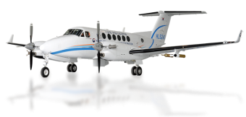
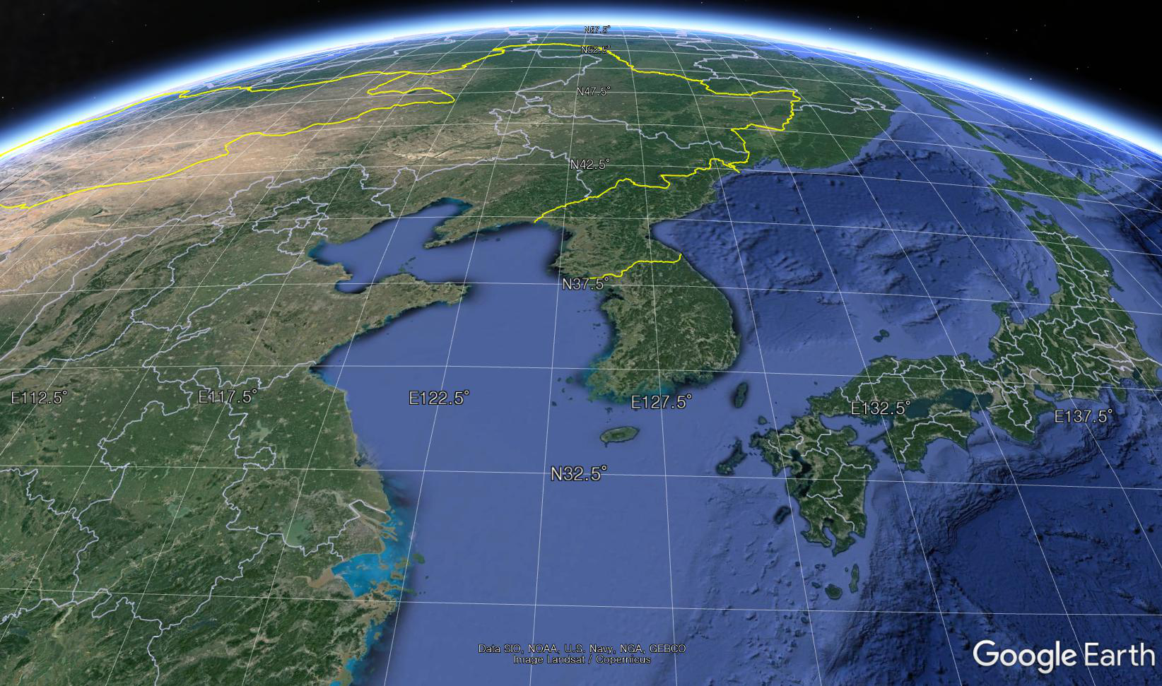
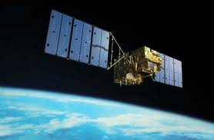
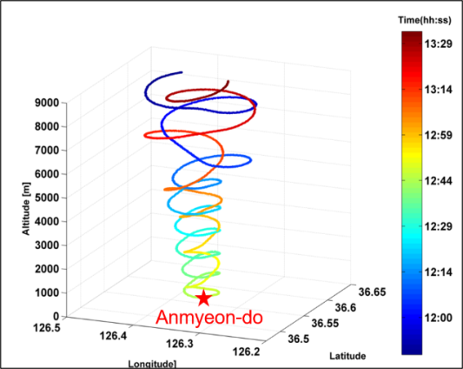
In-situ Vertical Profiles at AMY Surface GAW station
Model
TCCON
Satellite
Aircraft
Vertical profile
China
Anmyond do (AMY)
Japan
고산
Li et al., 2020
Flight altitude: 0.5 ~ 9 km
- Flight Area: Around Anmyeon-do
- Flight time: 12-14:00LST, coincided with over passes of the GOSAT
Flight interval: once per month
Scientific Goal:
- Utilize to compare and verify Satellite, Model simulation data
- Provide the Seasonal climatology of GHG Vertical distributions
over AMY region

Slide 6
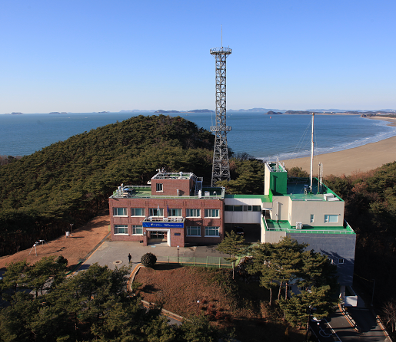
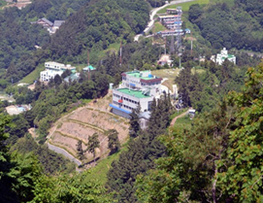
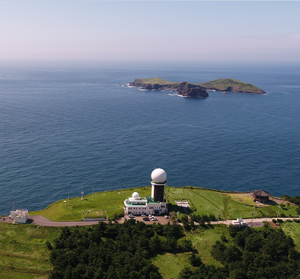
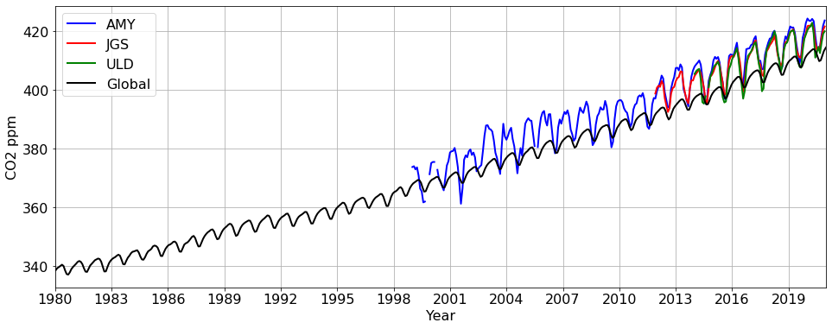
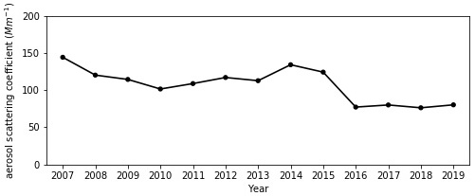
Surface stations in Korea
AMY
ULD
China
Ulleung do (ULD)
Anmyond do (AMY)
Japan
JGS
Gosan(JGS)
GHGs
AMY station has the longest in-situ measurements of GHGs and Aerosol in South Korea.
NIMS also expanded the GHG monitoring network to southwest (Jeju Gosan) and the east (Ulleungdo) for better understanding the regional source and sinks.
Ground-based FTS has been measuring several atmospheric GHGs and other gases (e.x. CO₂, CH₄, CO, N₂O and H₂O) at AMY, as a part of Total Carbon Column Observing Network (TCCON) since 2014.
Aerosol (AMY)
Figures from KAM GAW report, 2020

Slide 7
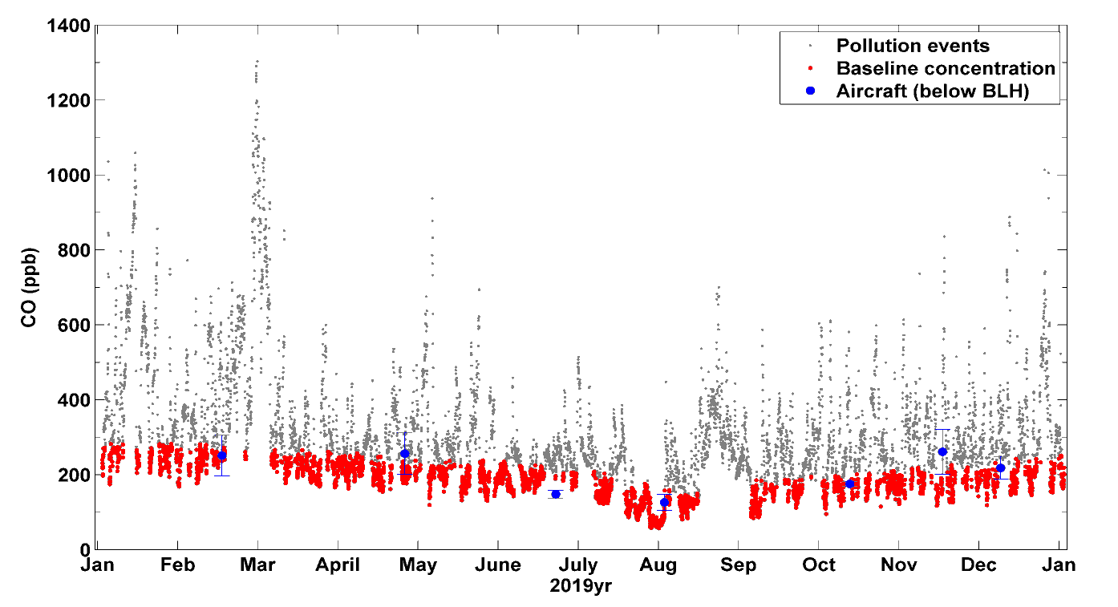
In-situ Surface and Aircraft CO Observation at AMY, a GAW station
Identify Potential Emission Source Distribution of Surface CO
CO observed at surface in 2019 over AMY
Footprint for CO spikes at surface
Extremely high CO spikes (≥ 80th percentile of CO).
The surface data were identified with background and pollution data, respectively.
The aircraft observations under BLH height were within the regional background surface value of CO, however, CO measured on April and November 2019 were slightly higher than that of the background.
Statistical trajectory analyses of one-year surface in situ observations of CO reveal that CO-emission sources from eastern China contributed to extremely high CO spikes (≥ 80th percentile of CO or ≥ 350 ppb) in 2019

Slide 8
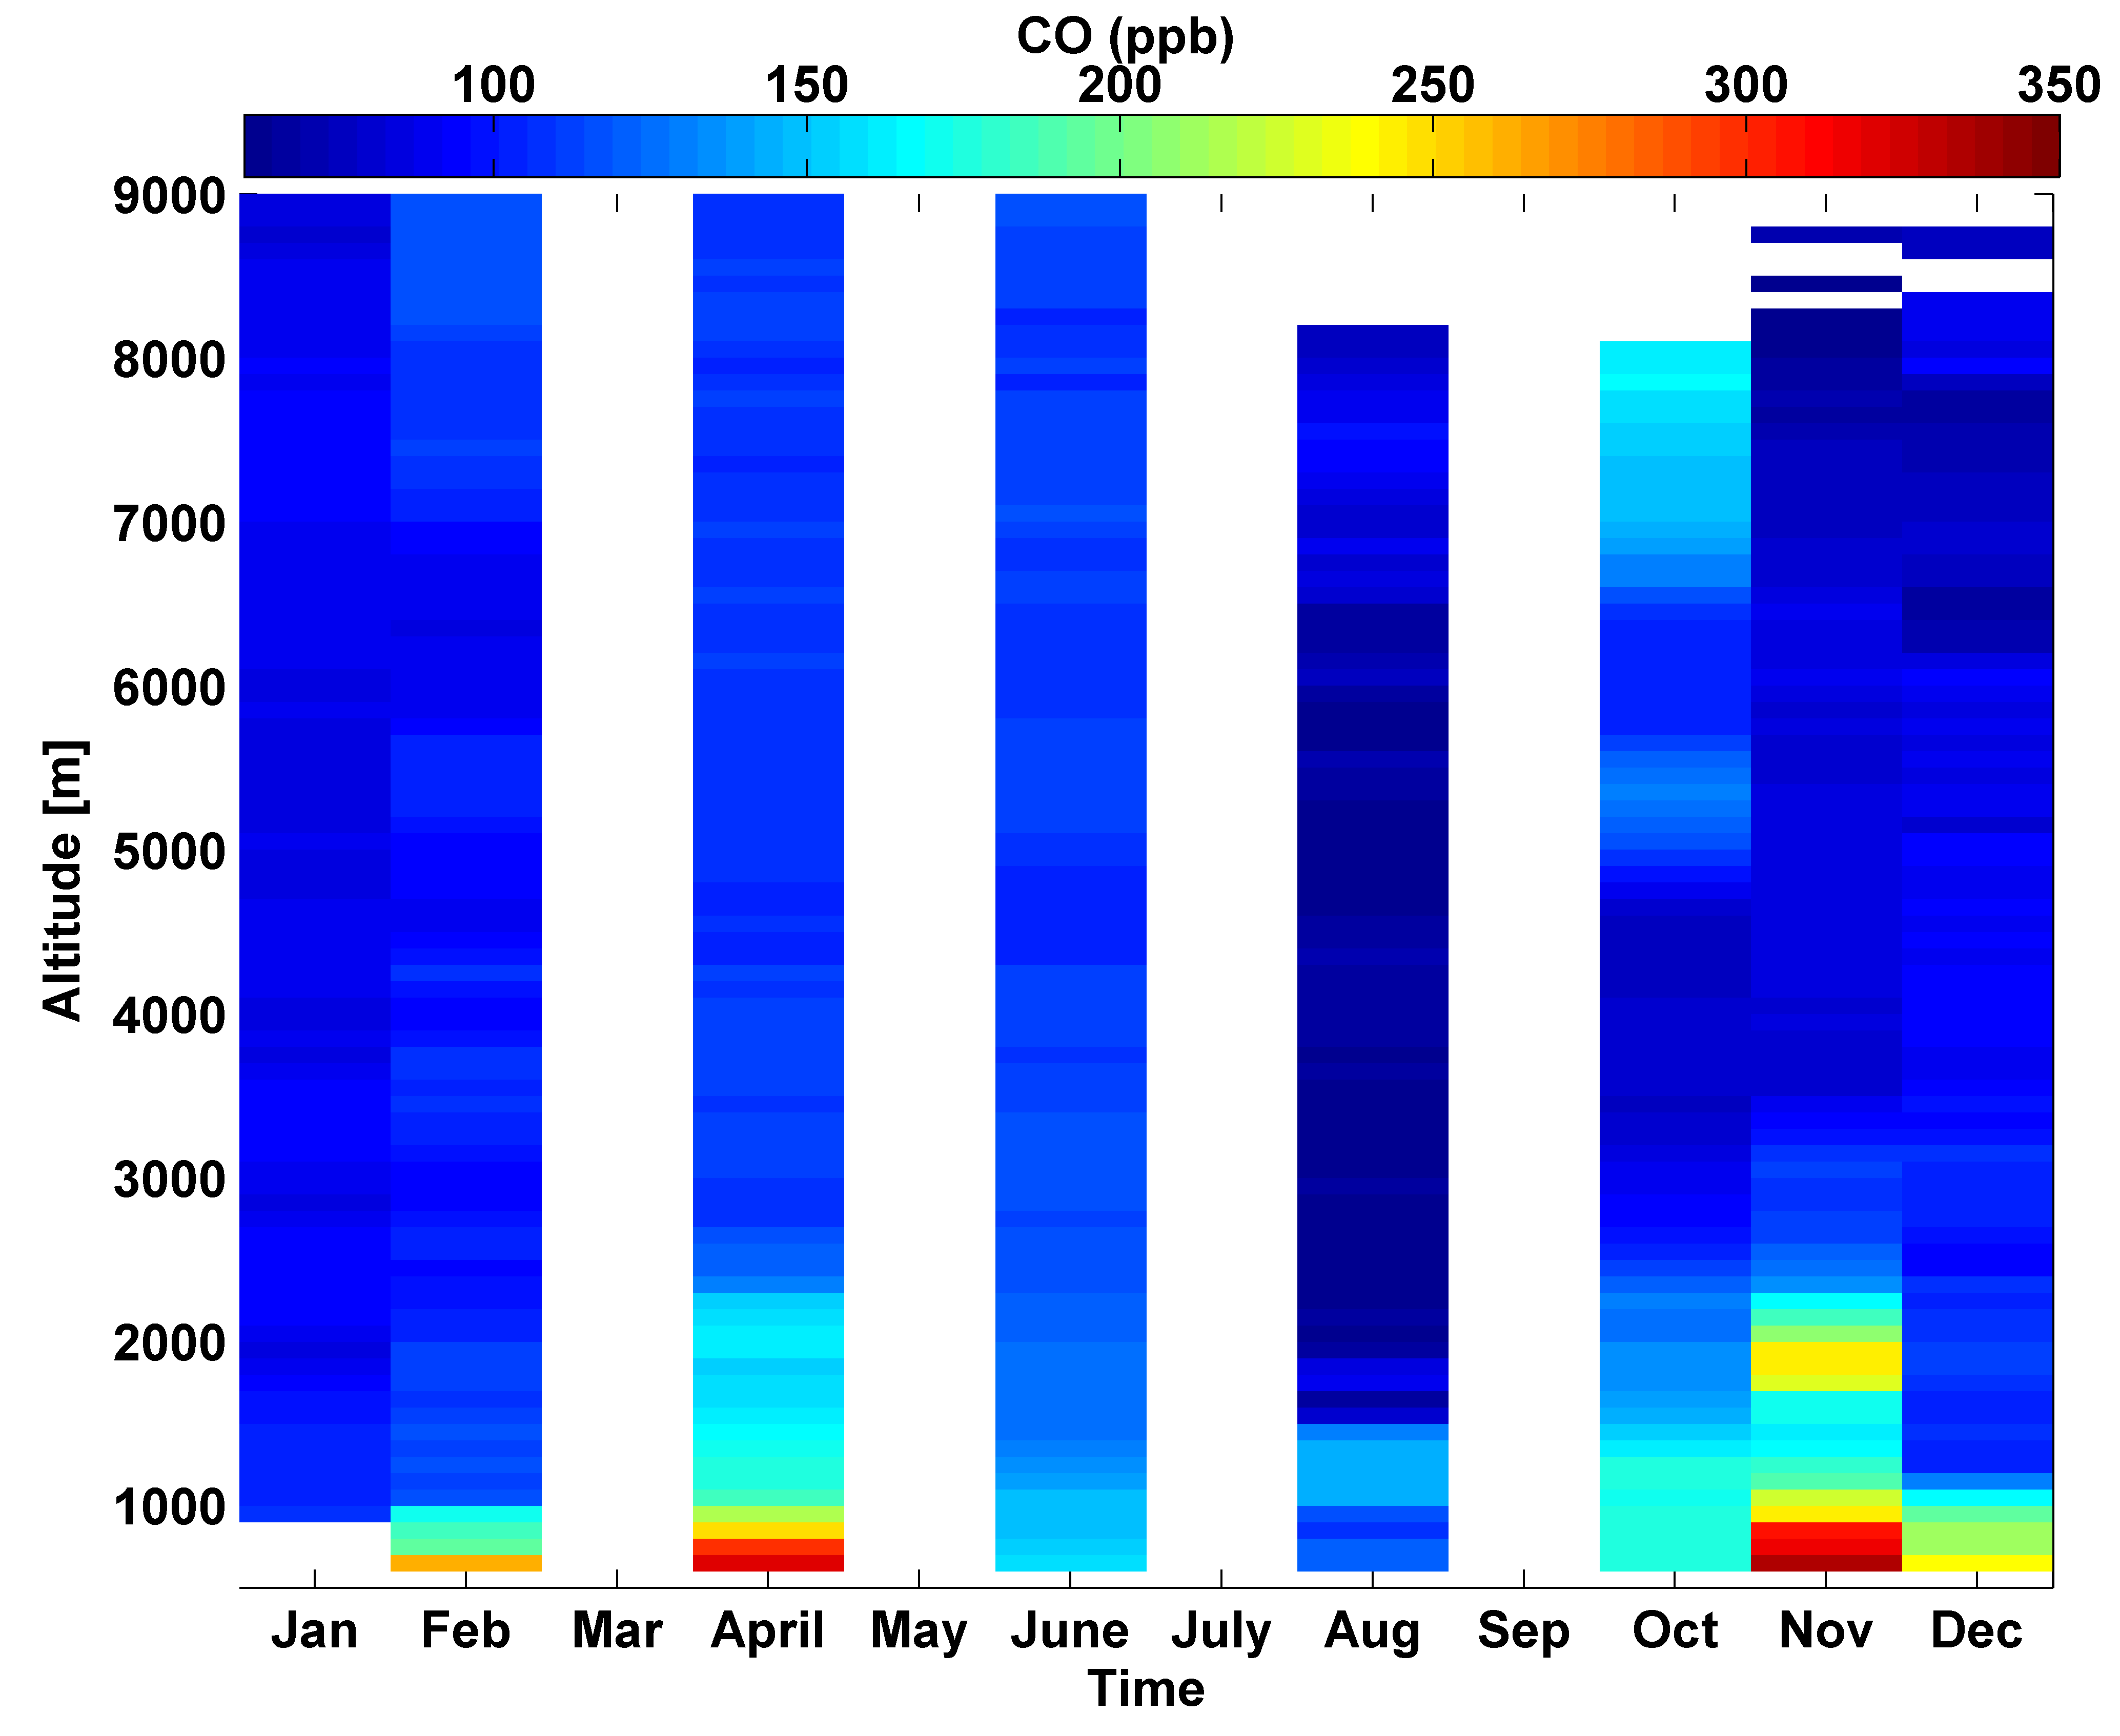
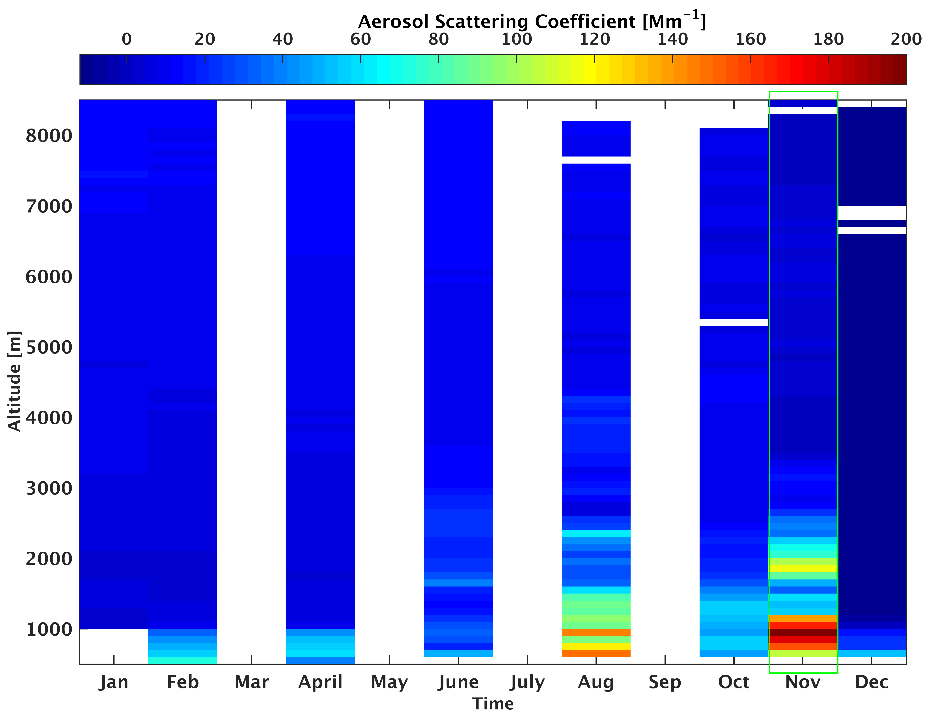
In-situ Vertical Profiles of air pollutions at AMY GAW station
Vertical Distributions of Aerosol Scattering & CO for all flights over AMY (2019yr)
Vertical structure of CO at AMY
Vertical structure of aerosol at AMY
Aerosol Scattering Coefficient & CO : The combustion sources emit particulate matter (PM) and CO together, Concurrent high plumes of CO and PM can be influenced by common anthropogenic combustion sources, especially in November.

Slide 9
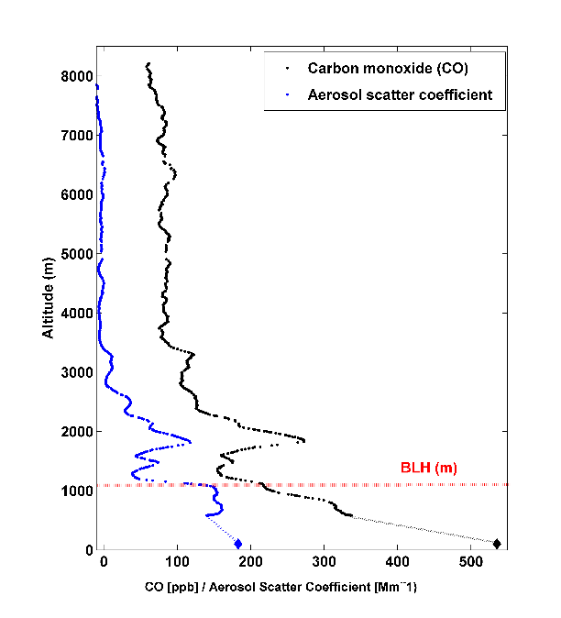
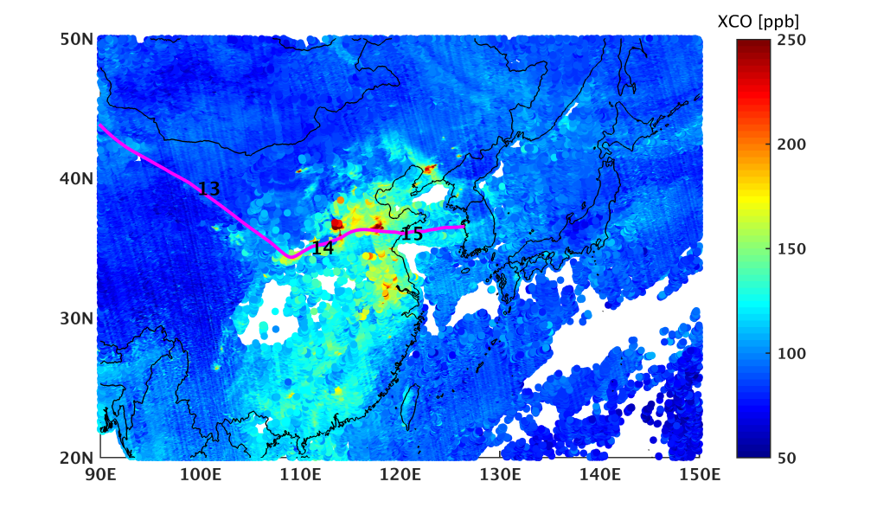
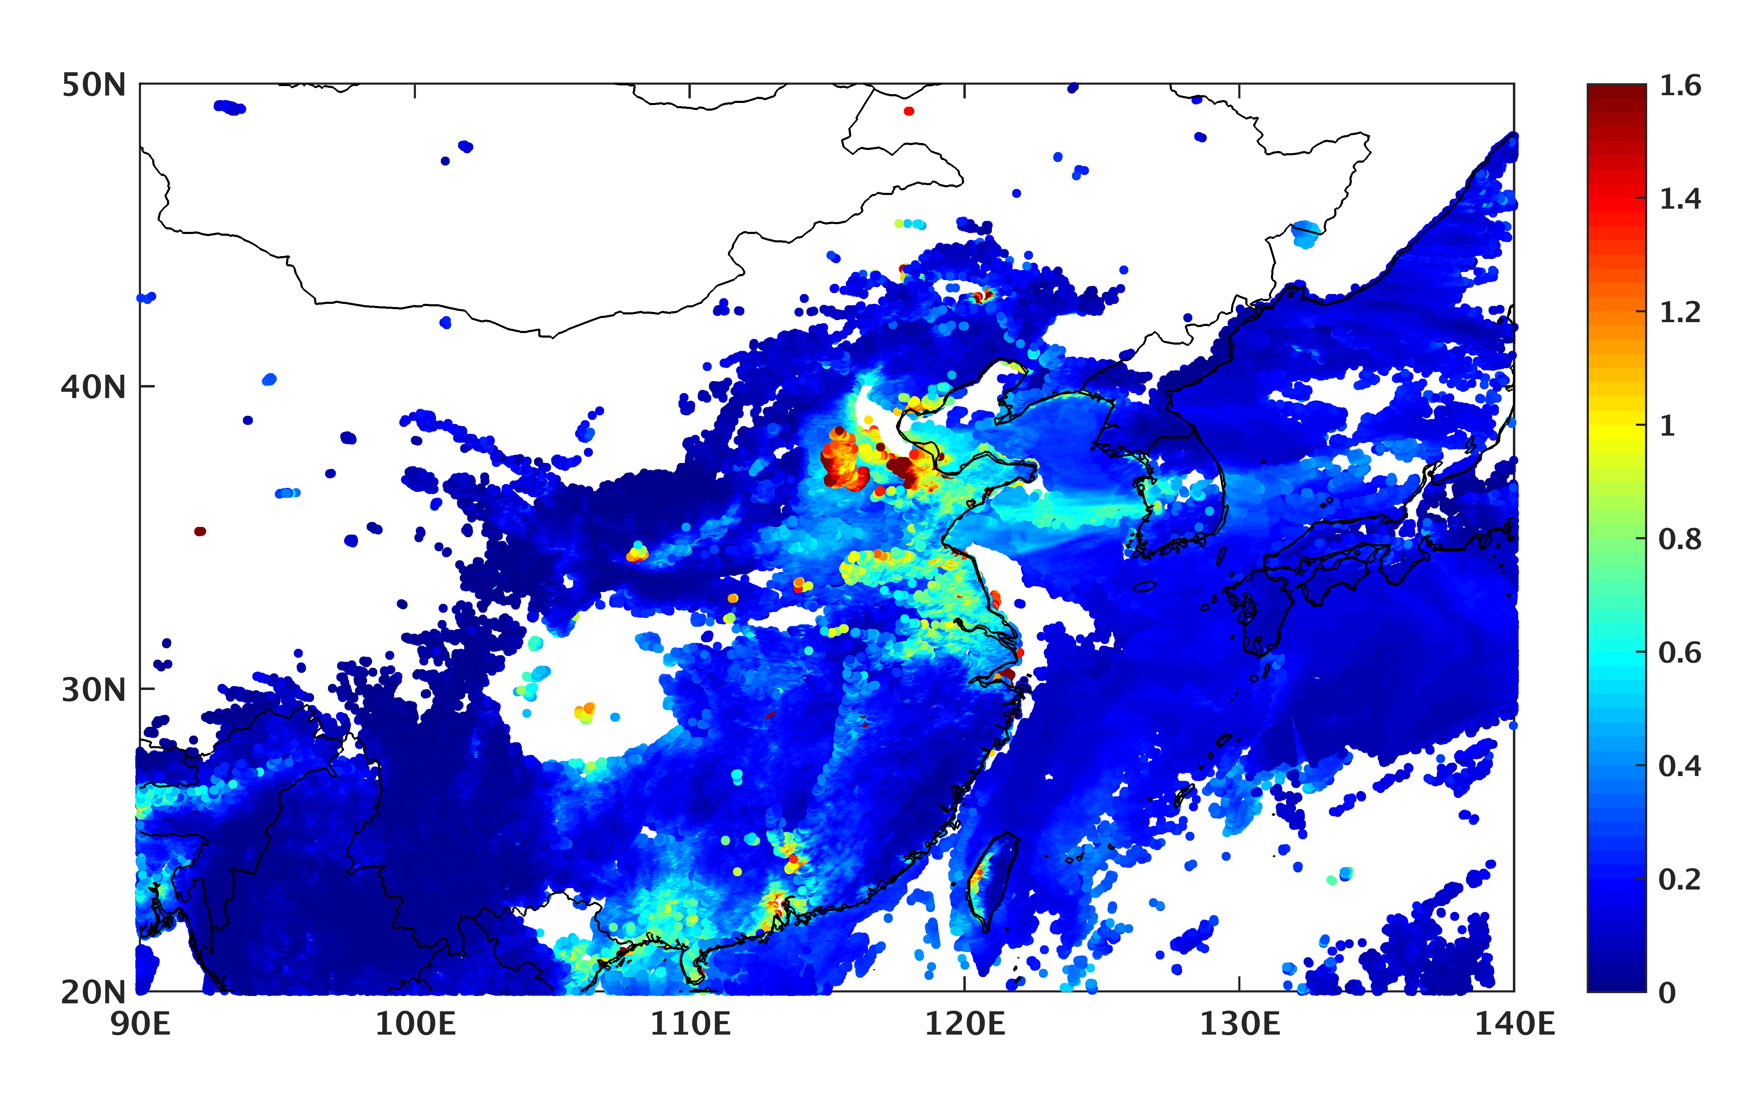
In-situ Vertical Profiles of air pollutions at AMY GAW station
Convective lifting, long-range transport of CO and aerosol in low troposphere
Flight on 16 Nov. 2019
TROPOMI XCO on 15-16 Nov. 2019 (5x7 km)
3-days back trajectory arrived at 2 km
MODIS AOD on 15-16 Nov. 2019 (3 km)
Emission sources differed below and above the BLH altitude.
MODIS AOD clearly shows that pollution plum transported to northern part of Korea from Eastern China via Yellow sea

Slide 10
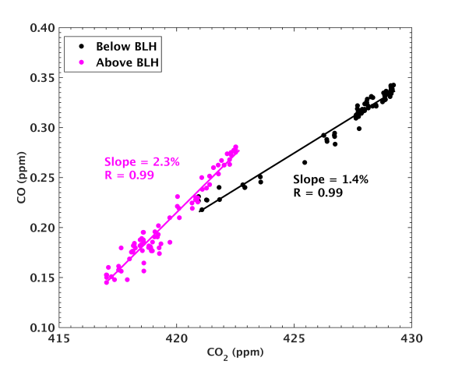
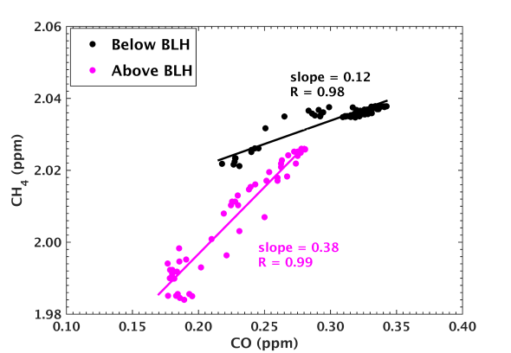
In-situ Vertical Profiles of air pollutions at AMY GAW station
Convective uplifting, long-range transport of CO and aerosol in low troposphere
Flight on 16 Nov. 2019
Common anthropogenic combustion sources
Carbon monoxide(CO): Comes from incomplete combustion of carbon-containing fuel
Slope of △CO/△CO₂ : High-efficiency combustion converts fuel carbon almost entirely into CO₂ → Used to characterize regional source signatures, as the majority of atmospheric CO.
Slope of △CH₄/△CO: Identify the FF (0.2-0.4), BB and Biofuel Source (0.1-0.2)
Emission sources differed below and above the BLH altitude.
We identified the different source of CO observed below BLH (Likely domestic burning of biomass or biofuel) and above BLH (fossil fuel) with the slopes of CO₂/CO and CH₄/CO
Li et al., 2022

Slide 11
Summary
A new KMA King Air aircraft research platform were established and started the regular observations over KOREA since 2018.
AMY, a WMO/GAW regional station in Korea, provides continuous observations of CO, GHGs, Aerosol at surface and vertical profiles within 0.5-9 km that are also collected by aircraft campaigns with 0.25 ppm, 3 ppb, 4.5 ppb precisions for CO2, CH4 and CO respectively.
Emissions from eastern China have a potentially leading role in the observed high pollution events at the surface and the lower FT over the AMY station in 2019 -> we need the continuous monitoring and analyze the vertical structure for more cases
Li et al., 2020, 2022

Slide 12
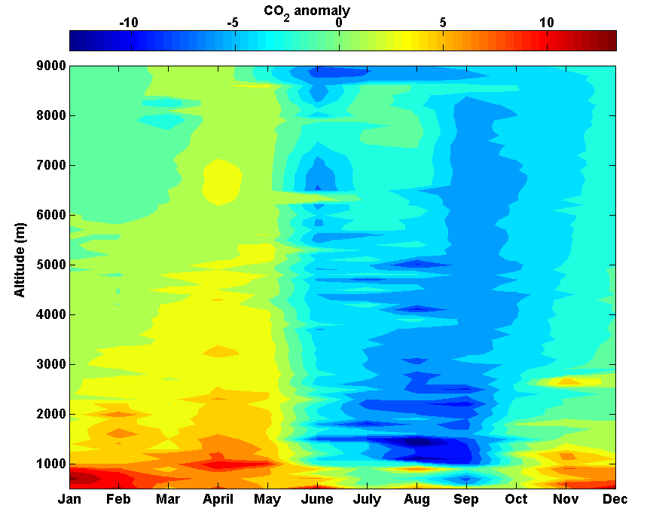
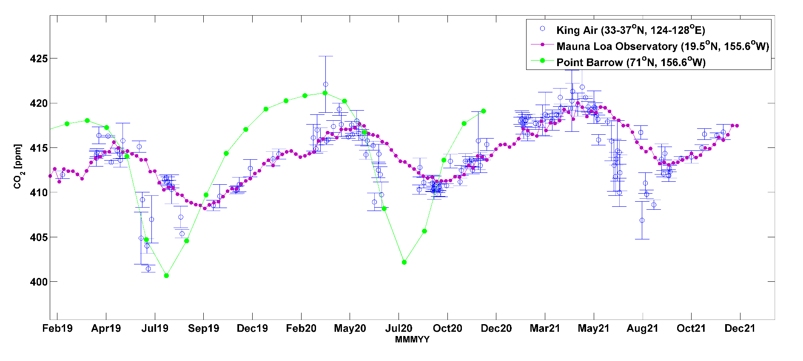
Ongoing works: Climatological Seasonal variations
Seasonal-Vertical variations over Korea
(2019-2021)
Accumulated Flight track (2018-2021)
Averaged CO₂ Time series above 3 km
MLO and Point Barrow data from WDCGG
MLO and Point Barrow data from WDCGG
Detrended with MLO
Spatial-Seasonal variations relative to data from Mauna Loa Observatory
→ More than 160 (~640 hours) flights record were integrated from 2018 to 2021,
which were covered the Korean region to understand the climatological CO₂ seasonal-vertical variation
We are going to achieve the vertical flask sampling of ¹³C-CO₂, ¹⁴C-CO₂ and ¹³C-CH₄ from 2022.
→ It is able to more clearly identify the CO₂ and CH₄ source signature through FT

Slide 13
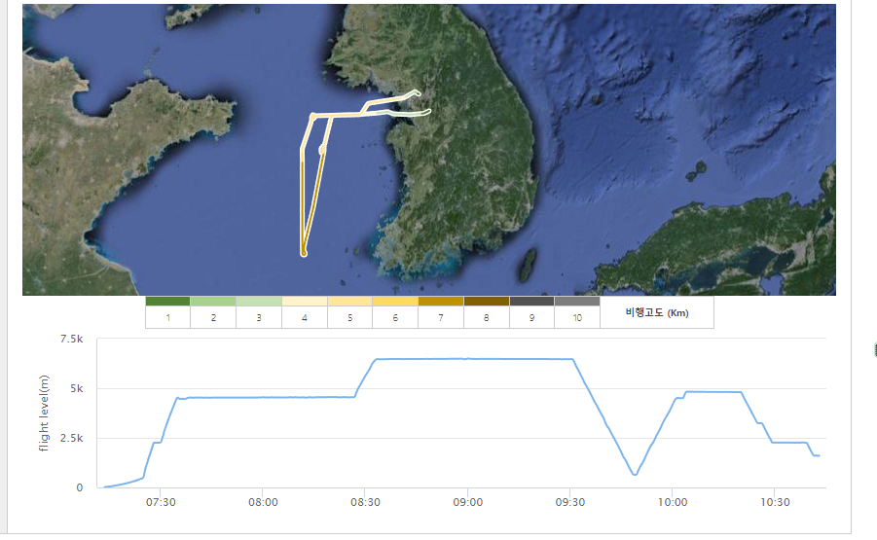
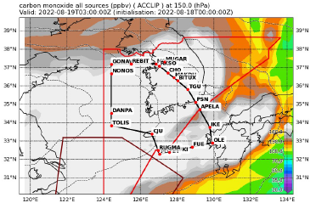
Ongoing work: Matching Flight with 2022 ACCLIP Campaign
NCAR GV flight Route
(2022-8-19)
King Air 350 Flight Route
Aerosol number distributions
The King Air 350 also participated the 2022 ACCLIP campaign, the data will be uploaded in NCAR/EOL

Slide 14
Thank You for
your attention
sunranlee@korea.kr
Sunranlee18@gmail.com

